Slide 1
WEB Application Development
Lab work – 1
GitHub

Slide 2
Steps :
A. In PC
1. Download and Install Git
2. Set Git in Environment Path (In user variables for "PC-USER", look for git/bin/ in Program Files)
3. Create A folder where you will work
4. set global git user name and email
5. git init
B. In GitHub
1. Create a repository
2. Copy the repository url
C. In PC
1. add remote origin in your working folder
2. git pull origin master
3. Make some changes in any file or add new ones
4. git status
5. git add . (if you want to stage all changed files or git add myfolder/somefile.js)
6. git status
7. git commit -m "added new changes to somefile.js"
8. git push origin master

Slide 3
git
git init
git config --global user.name "Farzana Sadia"
git config --global user.email "sadia.swe@diu.edu.bd"
git remote add origin https://github.com/sadia-swe/Test1.git
git pull origin master
git status
git add .
git status
git commit -m "Changes in files"
git status
git push origin master

Slide 4
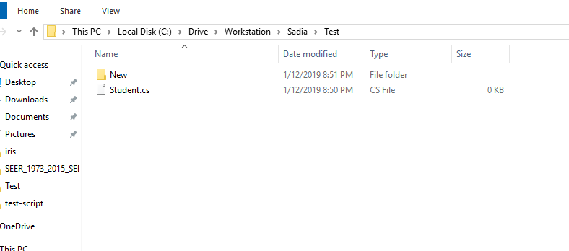

Slide 5
Install git: https://git-scm.com/download/win

Slide 6
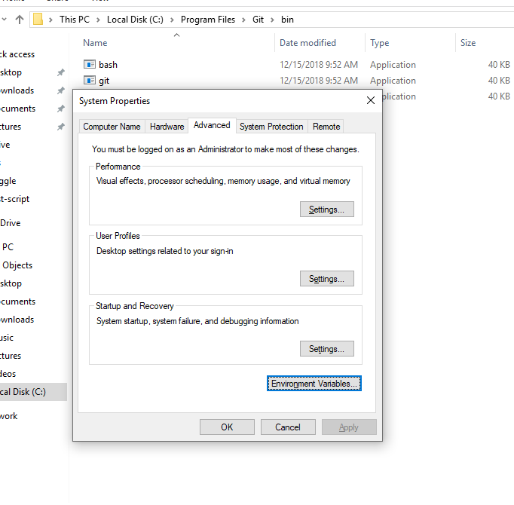
Bin file path

Slide 7
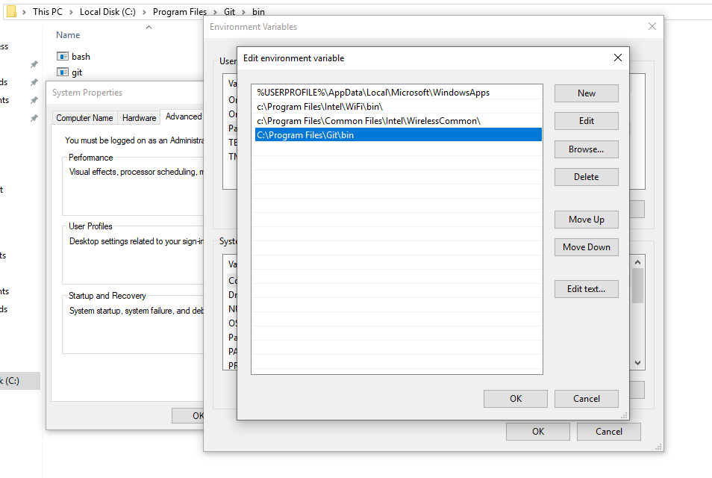

Slide 8
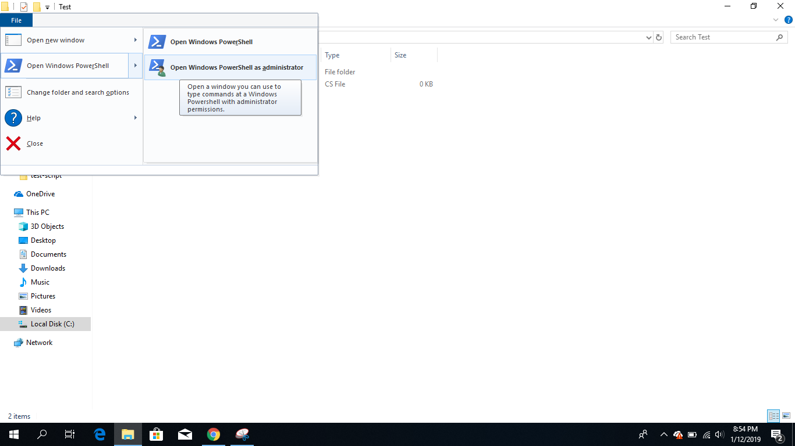

Slide 9
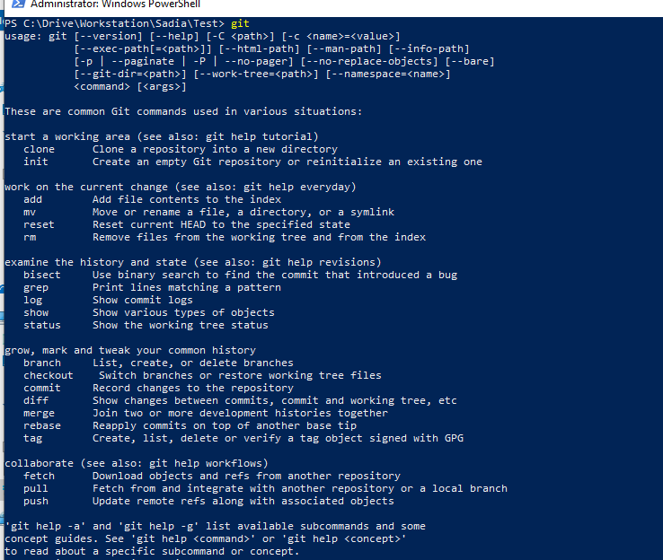

Slide 10
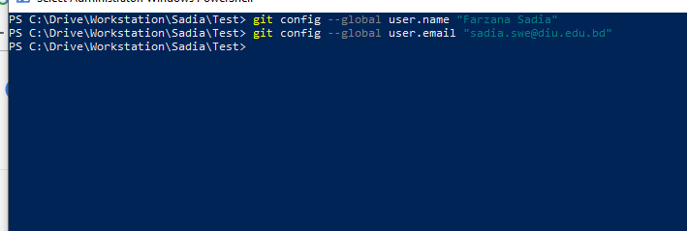

Slide 11
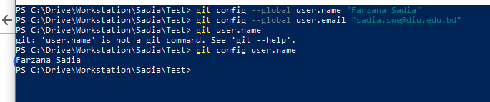

Slide 12
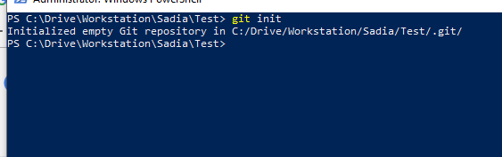

Slide 13
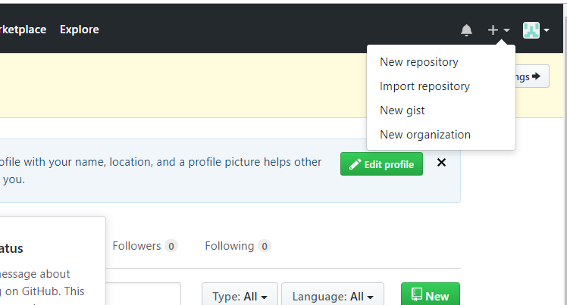

Slide 14
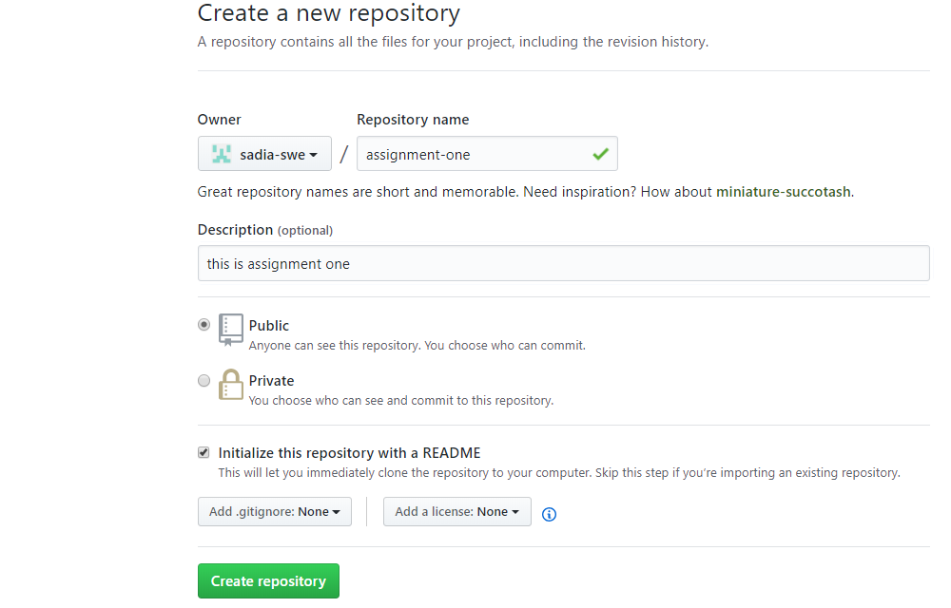

Slide 15
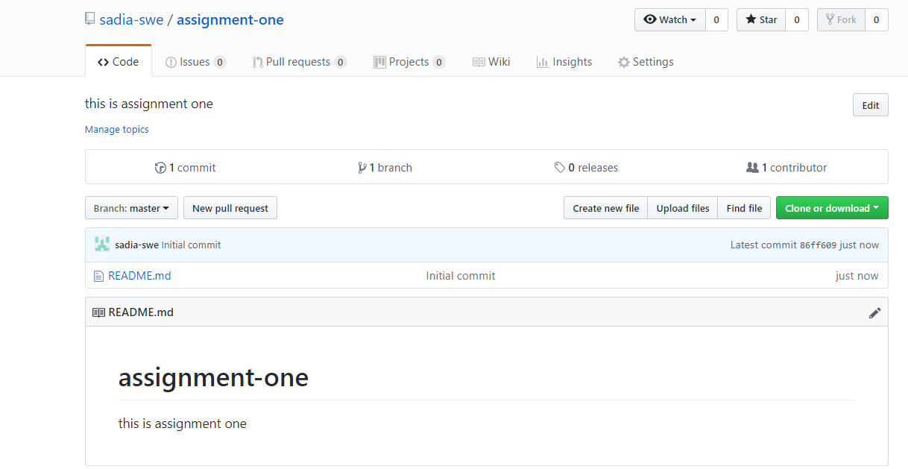

Slide 16
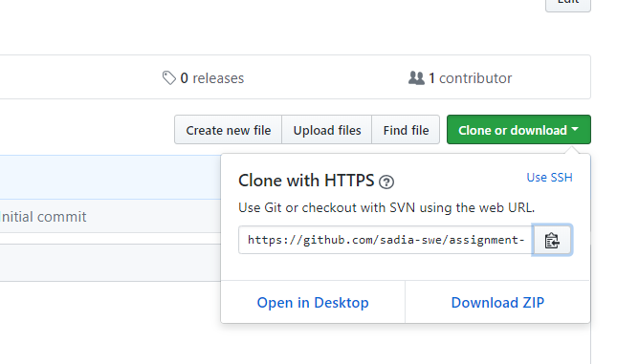
url

Slide 17
push

Slide 18
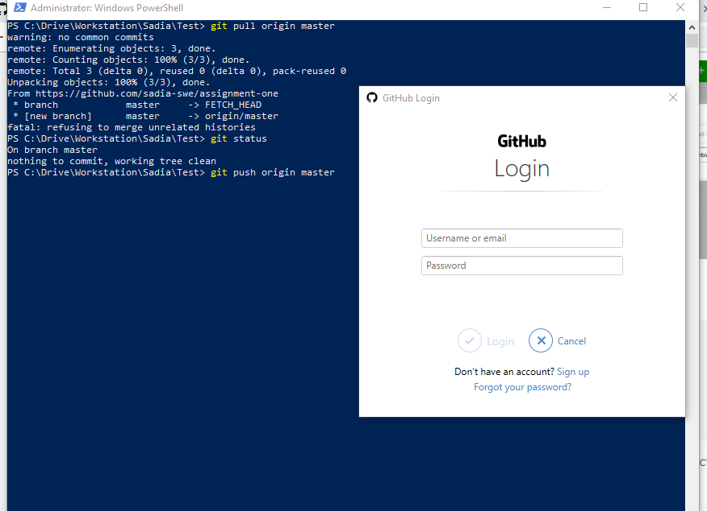

Slide 19
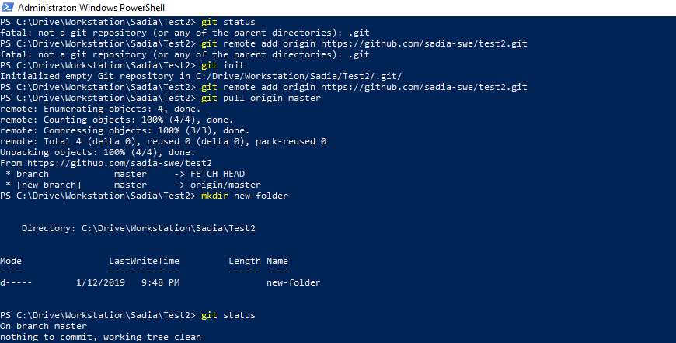

Slide 20
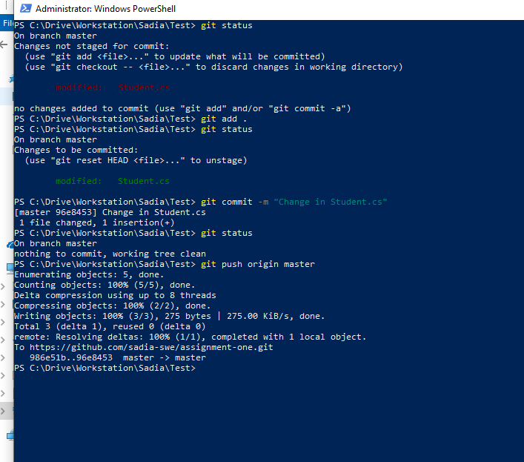

Slide 22
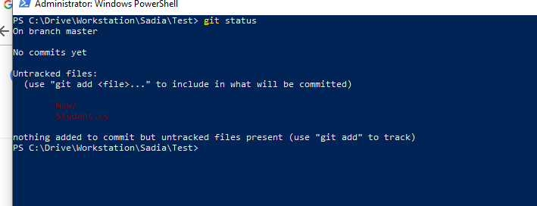

Slide 23
